Slide 1
Digital Portfolio
STUDENT NAME: KEERTHANA S
REGISTER NO AND NMID: 212401009/04DE03493927BE4AA18469B385B31E64
DEPARTMENT: COMPUTER APPLICATIONS
COLLEGE: UNIVERSITY OF MADRAS

Slide 2
PROJECT TITLE
DIGITAL PORTFOLIO USING FRONT END WEB DEVELOPMENT

Slide 3


AGENDA
Problem Statement
Project Overview
End Users
Tools and Technologies
Portfolio design and Layout
Features and Functionality
Results and Screenshots
Conclusion
Github Link
3/21/2024 Annual Review

Slide 4

PROBLEM STATEMENT
In today’s digital world, traditional resumes are not enough to highlight all achievements. A digital portfolio provides an interactive platform to showcase personal details, education, skills, and projects. Unlike a paper resume, it can include images, links, and certificates to make the profile more engaging. This project aims to create a responsive and user-friendly portfolio website. It will help students and professionals to present themselves effectively. Overall, a digital portfolio serves as a modern identity and increases career opportunities.

Slide 5

PROJECT OVERVIEW
This project is a personal digital portfolio website designed to present my information in an organized way.It contains sections like About Me, Education, Skills, Certificates, and Contact details.

Slide 6

WHO ARE THE END USERS?
The end users of this digital portfolio are mainly recruiters, employers, and companies who can evaluate my skills, education, and achievements for career opportunities. It can also be useful for teachers and mentors to review my academic progress and certifications. In addition, peers and general viewers can access the portfolio to know more about my personal profile and professional abilities.

Slide 7

TOOLS AND TECHNIQUES
Tools Used:
Visual Studio Code (VS Code) – Development environment
HTML – For creating the structure of the portfolio
CSS – For styling, layout, and design
JavaScript – For interactivity and responsiveness
Techniques Applied:
Responsive web design for mobile and desktop compatibility
Use of clean layout and navigation for better user experience
Organized sections for About, Education, Skills, Certificates, and Contact
Consistent fonts, colors, and spacing for a professional look

Slide 8
POTFOLIO DESIGN AND LAYOUT
Portfolio Design:
Overall look and feel of the portfolio
Use of headings, images, and text to represent information
Simple, clean, and professional appearance
Portfolio Layout:
Header – Name, title, navigation links
About Section – Short introduction/profile
Education Section – Academic background
Skills Section – List of technical and soft skills
Certificates Section – Display of achievements and certifications
Contact Section – Contact details and links
8

Slide 9
FEATURES AND FUNCTIONALITY
The digital portfolio provides a simple and user-friendly interface to showcase personal details in an organized manner. It includes different sections such as About Me, Education, Skills, Certificates, and Contact, allowing clear presentation of information. The portfolio has smooth navigation with responsive design so that it works well on desktops, tablets, and mobile devices. It also features interactive elements like hover effects, animations, and a contact form with validation, making the portfolio more engaging and professional.

Slide 10

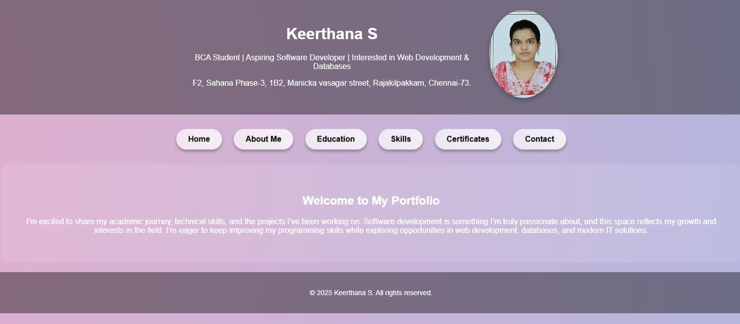
RESULTS AND SCREENSHOTS
The digital portfolio project was successfully developed and implemented. It provides a professional platform to present personal information, education, skills, certificates, and contact details in a structured and visually appealing manner. The portfolio is responsive, user-friendly, and accessible across different devices. It also includes interactive elements and smooth navigation, making it more engaging.
3/21/2024 Annual Review
10

Slide 11
CONCLUSION
The project achieved its goal of creating a digital portfolio that effectively presents personal and academic details. With its responsive design and simple interface, the portfolio serves as a professional platform to highlight skills and achievements.
11

Slide 12
GITHUB LINK
https://13221bca2024-coder.github.io/KEERTHANA-S/

